Slide 1
Standards
Step 1
Step 2
Step 3
Step 4
Campus
CE
ME
LE
RE
LE
SE
KMS
GRADE
3RD
4TH
5TH
6TH
SUBJECT
RLA
MATH
ENG I
BIO
TEACHER
ALL
T1
T2
T3
T4

Slide 2
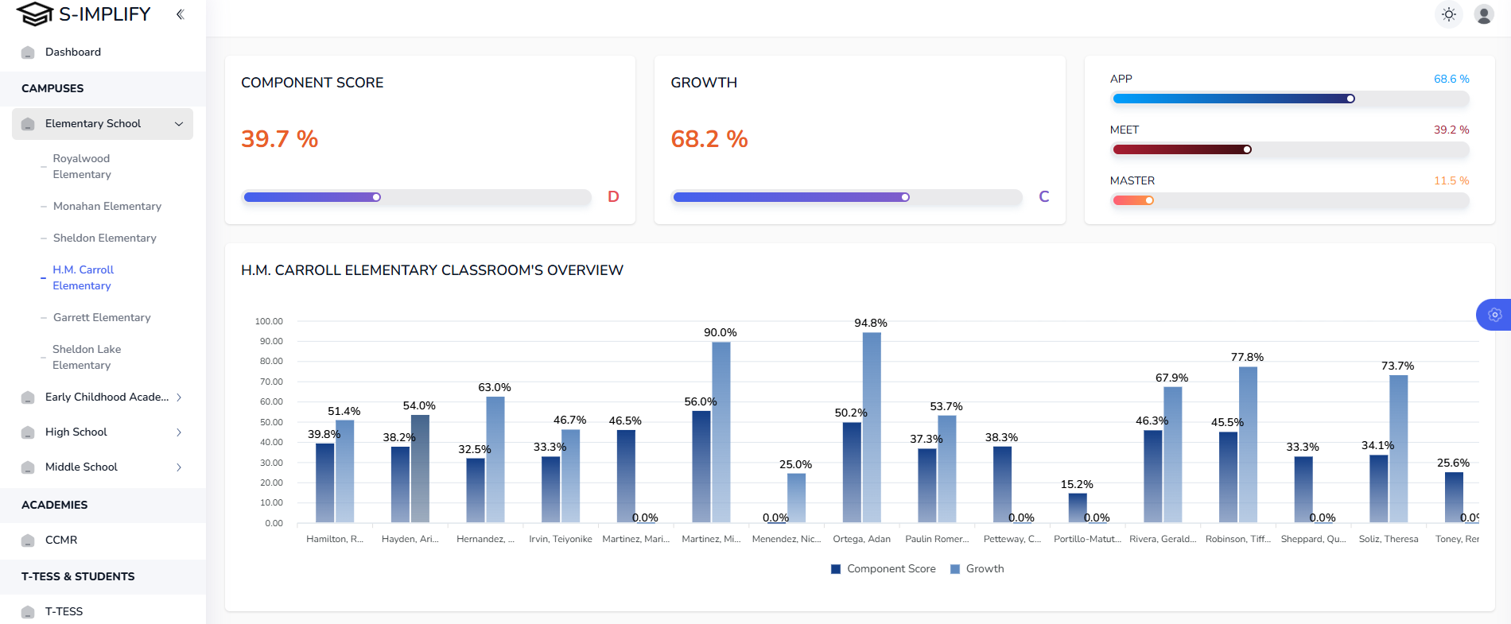
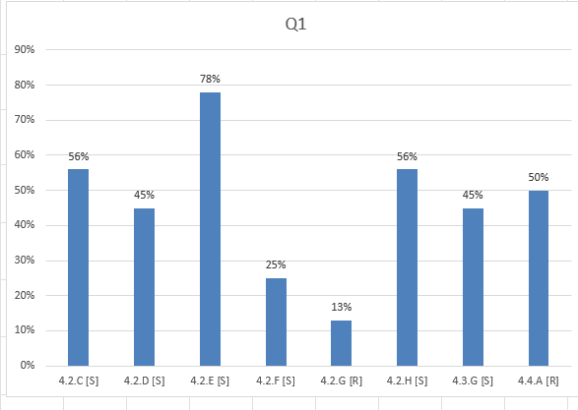
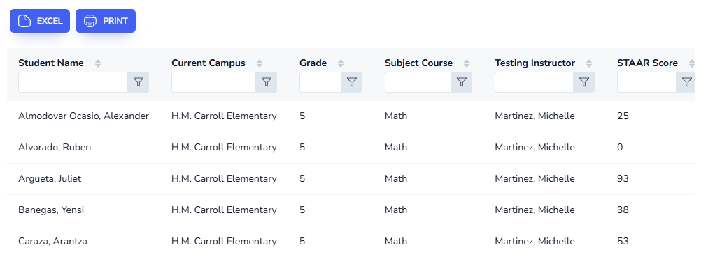
CAMPUS 4th Grade Math

Slide 3
Mrs. Smith 4th Grade Math

